Slide 1
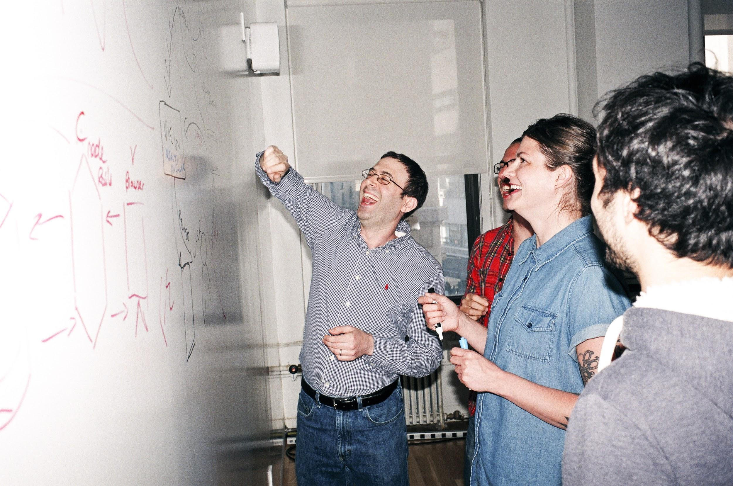

Welcome to General Assembly
WiFi GA Guest
Password yellowpencil
Notes:
[Leave this slide visible until presentation starts]

Slide 2
DATA SCIENCE
10 WEEK PART TIME COURSE
Lesson 14: - Introduction to R - Introduction to Time Series

Slide 3
Course Plan
Final Countdown!

Slide 4
Git & GitHub – 1 Pager Guide!

Slide 5
AGENDA
R – installing & setup
R – introduction
Time Series Introduction
Lab
Discussion – Final Projects

Slide 6

DATA SCIENCE PART TIME COURSE

Slide 7
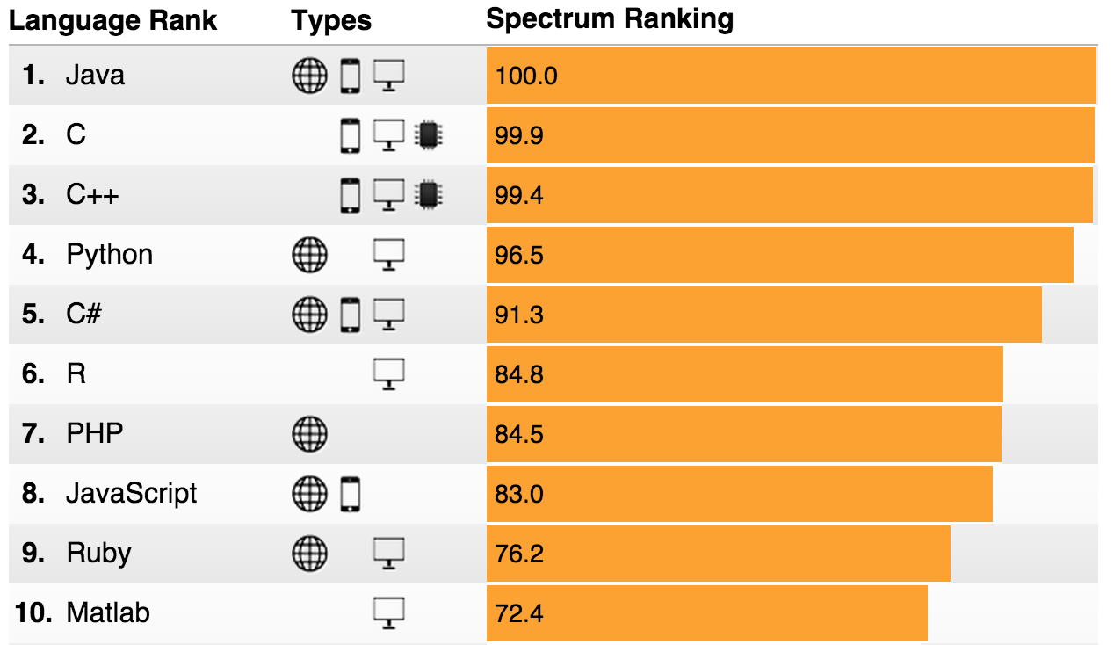
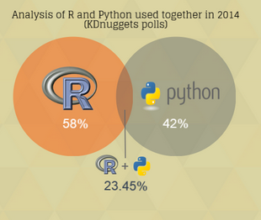
PYTHON & R
IEEE Spectrum Survey 2015
DataCamp Infographic 2015

Slide 8
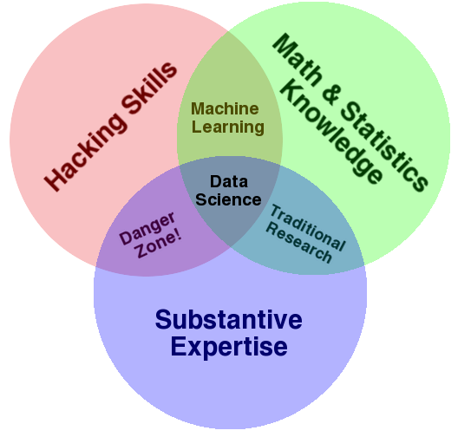


PYTHON & R

Slide 9
To-Do List
1. Getting started with R: Option 1 – Use R-Studio on the server: http://paulgoodall.tech/rstudio/ Option 2 – Download & Install R and R-Studio (15mins) 2. SWIRL intro to R: (includes install instructions – can skip to step 4) http://swirlstats.com/students.html Go through the courses: [R Programming] [Getting and Cleaning Data] 3. Read first 2 chapters of Forecasting Principles and Practice https://www.otexts.org/fpp (20 mins)
DATA SCIENCE – Lesson 14

Slide 10
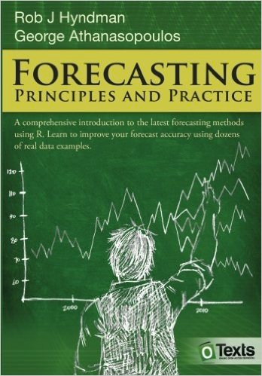
FORECASTING: PRINCIPLES & PRACTICE
1 Getting started
2 The forecaster's toolbox
3 Judgmental forecasts
4 Simple regression
5 Multiple regression
6 Time series decomposition
7 Exponential smoothing
8 ARIMA models
9 Advanced forecasting methods
10 Data
12 Using R

Slide 11
WHAT IS A TIME SERIES?
DATA SCIENCE PART TIME COURSE

Slide 12
WHAT IS A TIME SERIES?
A time series is a series of data that is observed sequentially over time.
Examples include:
Weekly Rainfall
Daily Stock price of Atlassian
Quarterly oil import figures

Slide 13
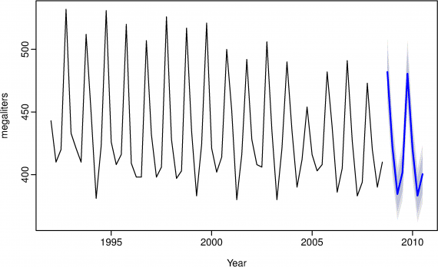
WHAT IS A TIME SERIES?

Slide 14
WHAT MAKES A TIME SERIES DIFFERENT?
In other words, why wouldn’t we just use linear regression and have the time variable as our X values?
y=β0+β1x+ε.

Slide 15
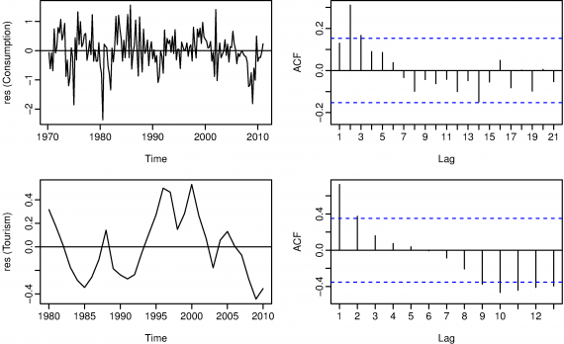
WHAT MAKES A TIME SERIES DIFFERENT?
With time series data it is highly likely that the value of a variable observed in the current time period will be influenced by its value in the previous period, or even the period before that, and so on…

Slide 16
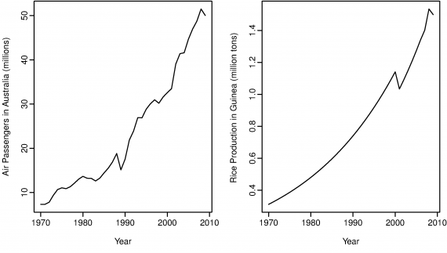
WHAT MAKES A TIME SERIES DIFFERENT?
Time Series will often be ‘non-stationary’, that means that you do not have a zero mean or constant variance. This can lead to spurious regressors (factors considered influential in a model that are actually not).

Slide 17
TIME SERIES COMPONENTS
There are three time series components we will use to describe a time series
Trend
Seasonal
Cyclic

Slide 18
TIME SERIES COMPONENTS - TREND
A trend exists when there is a long-term increase or decrease in the data. It does not have to be linear. Sometimes we will refer to a trend “changing direction” when it might go from an increasing trend to a decreasing trend.
Example:

Slide 19
TIME SERIES COMPONENTS - SEASONAL
A seasonal pattern exists when a series is influenced by seasonal factors (e.g., the quarter of the year, the month, or day of the week). Seasonality is always of a fixed and known period.

Slide 20
TIME SERIES COMPONENTS - CYCLIC
A cyclic pattern exists when data exhibit rises and falls that are not of fixed period. The duration of these fluctuations is usually of at least 2 years.

Slide 21
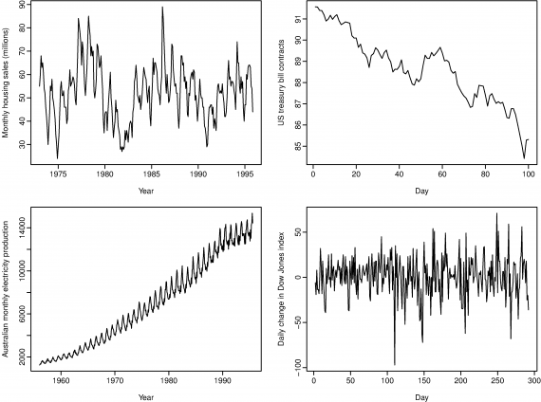

Slide 22
TIME SERIES COMPONENTS
Top Left: strong seasonality within each year, as well as some strong cyclic behaviour with period about 6–10 years. No Trend
Top Right: no seasonality, but an obvious downward trend. If we had more data we may be able to observe a cycle
Bottom Left: strong increasing trend, with strong seasonality. No cycle
Bottom Right: no trend, seasonality or cyclic behaviour

Slide 23
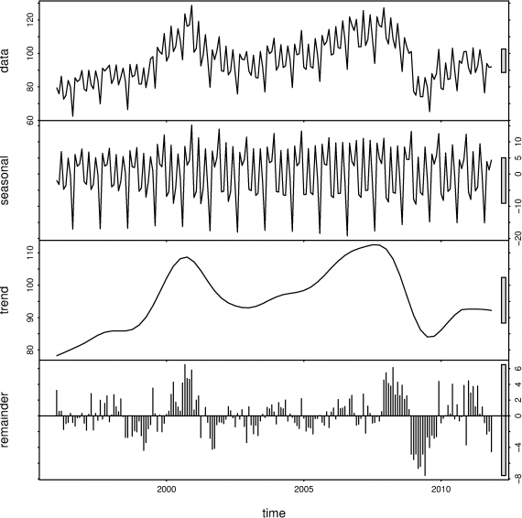
WHAT IS A TIME SERIES DECOMPOSITION?
Time Series Decomposition is a way to break down a time series into the Season, Trend (which includes the cycle) and Remainder.

Slide 24
TIME SERIES MODELS - EXPONENTIAL SMOOTHING
We can consider these to be weighted averages of past observations. This means that the more recent the observation, the higher the weighting of that observation.
The Naive model is the case where the forecast is equal to the last observed value,
Y_{t+1} = Y_{t}
What if we were to weight the observations to have decreasing weights as the observations got older? What would the equation look like?

Slide 25
TIME SERIES MODELS - EXPONENTIAL SMOOTHING
ŷ t+1 | t = αyt + α(1−α)yt-1 + α(1−α)²yt-2 + ⋯
where 0 ≤ α ≤ 1 is the smoothing parameter.

Slide 26
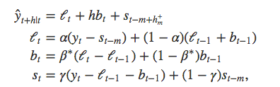
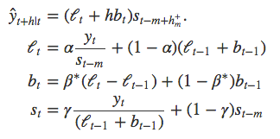
TIME SERIES MODELS - HOLT WINTERS
The Holt-Winters method captures level, trend and seasonality.
There are two variations to this method that differ in the nature of the seasonal component. The additive method is preferred when the seasonal variations are roughly constant through the series, while the multiplicative method is preferred when the seasonal variations are changing proportional to the level of the series.

Slide 27
ARIMA MODELS - STATIONARITY & DIFFERENCING
A stationary time series is one whose properties do not depend on the time at which the series is observed. So time series with trends, or with seasonality, are not stationary — the trend and seasonality will affect the value of the time series at different times. On the other hand, a white noise series is stationary — it does not matter when you observe it, it should look much the same at any period of time.
In general, a stationary time series will have no predictable patterns in the long-term. Time plots will show the series to be roughly horizontal (although some cyclic behaviour is possible) with constant variance.

Slide 28
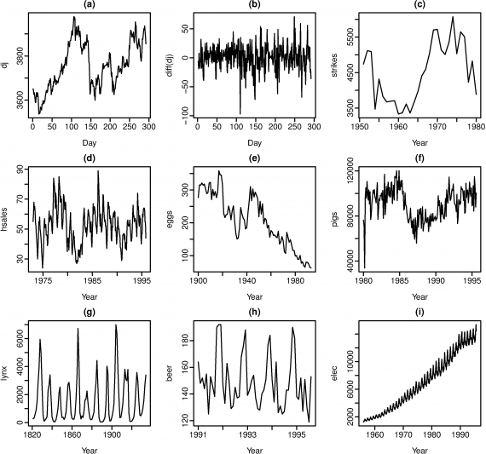

Slide 29
ARIMA MODELS - STATIONARITY & DIFFERENCING
seasonality rules out series (d), (h) and (i).
Trend rules out series (a), (c), (e), (f) and (i).
Increasing variance also rules out (i).
That leaves only (b) and (g) as stationary series. At first glance, the strong cycles in series (g) might appear to make it non-stationary. But these cycles are aperiodic

Slide 30
ARIMA MODELS - STATIONARITY & DIFFERENCING
One way to make a time series stationary is to compute the differences between consecutive observations.
Differencing can help stabilize the mean of a time series by removing changes in the level of a time series, and so eliminating trend and seasonality.
A seasonal difference is the difference between an observation and the corresponding observation from the previous year

Slide 31
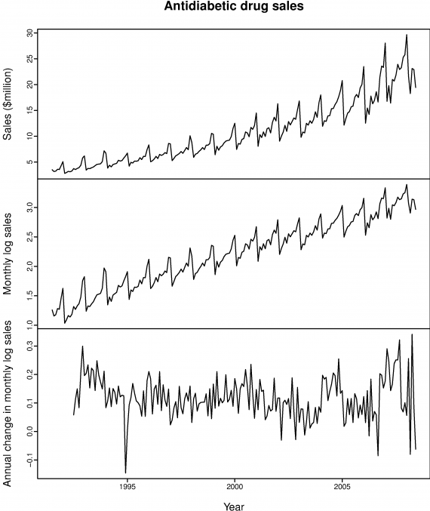

Slide 32
ARIMA MODELS - BACKSHIFT OPERATOR
The backward shift operator BB is a useful notational device when working with time series lags:
Byt = yt-1
Two applications of BB to yt shifts the data back two periods:
B(Byt) = B²yt = yt-2
(This is also known as a Lag operator)

Slide 33
ARIMA MODELS - AUTOREGRESSIVE (AR)
In an autoregression model, we forecast the variable of interest using a linear combination of past values of the variable. The term autoregression indicates that it is a regression of the variable against itself.
This is like a multiple regression but with lagged values of yt as predictors. We refer to this as an AR(p) model

Slide 34
ARIMA MODELS - MOVING AVERAGE (MA)
Rather than use past values of the forecast variable in a regression, a moving average model uses past forecast errors in a regression-like model.
We refer to this as an MA(q) model

Slide 35
ARIMA MODELS - PUTTING IT ALL TOGETHER
If we combine differencing with autoregression and a moving average model, we obtain a non-seasonal ARIMA model. ARIMA is an acronym for AutoRegressive Integrated Moving Average model (“integration” in this context is the reverse of differencing).
We call this an ARIMA(p,d,q) model, where
p= order of the autoregressive part;
d= degree of first differencing involved;
q= order of the moving average part.

Slide 36
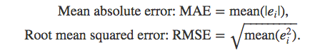
EVALUATING A TIME SERIES MODEL
The forecast error is simply ei=yi−ŷi, which is on the same scale as the data. Accuracy measures that are based on ei are therefore scale-dependent and cannot be used to make comparisons between series that are on different scales.

Slide 37
EVALUATING A TIME SERIES MODEL
The percentage error is given by pi=100ei/yi. Percentage errors have the advantage of being scale-independent, and so are frequently used to compare forecast performance between different data sets.
Mean absolute percentage error: MAPE=mean(|pi|)

Slide 38
CROSS-VALIDATION FOR TIME SERIES
The three parameters for this type of splitting in the R Caret package are:
initialWindow: the initial number of consecutive values in each training set sample
horizon: The number of consecutive values in test set sample
fixedWindow: A logical: if FALSE, the training set always start at the first sample and the training set size will vary over data splits.

Slide 39
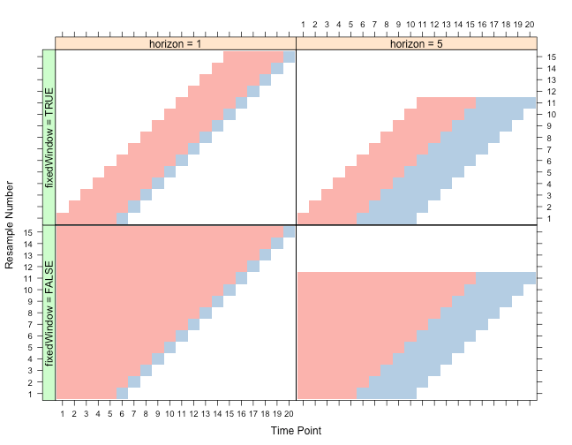

Slide 40
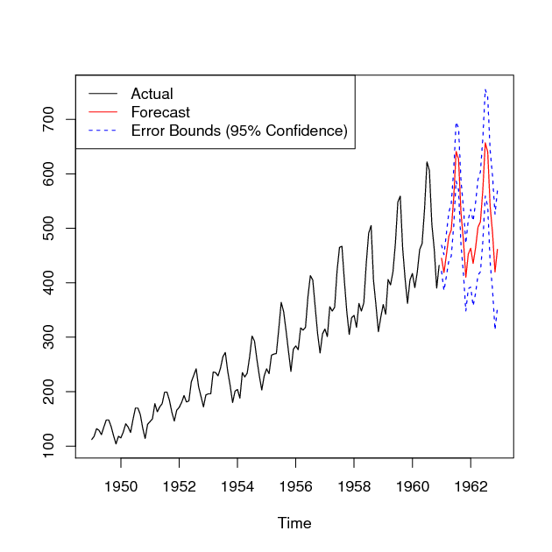
LAB
DATA SCIENCE PART TIME COURSE

Slide 41
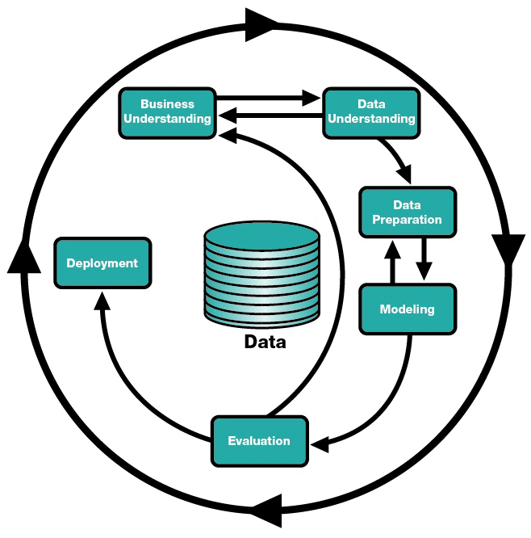
DATA SCIENCE CYCLE – Lesson 14

Slide 42
Lesson 14 - Review
FINAL PROJECT
- Final Project split into 4-parts: [Review with James 5mins]
(a) Real-world Problem Identification [Lesson 14]
(b) Data Cleaning [Lesson 15]
(c) Model & Validation [Lesson 16]
(d) Presentation & Storytelling [Lesson 17]
Lesson 18 – any final queries
Lesson 19 & 20 – Presenting final project back to class

